Slide 1

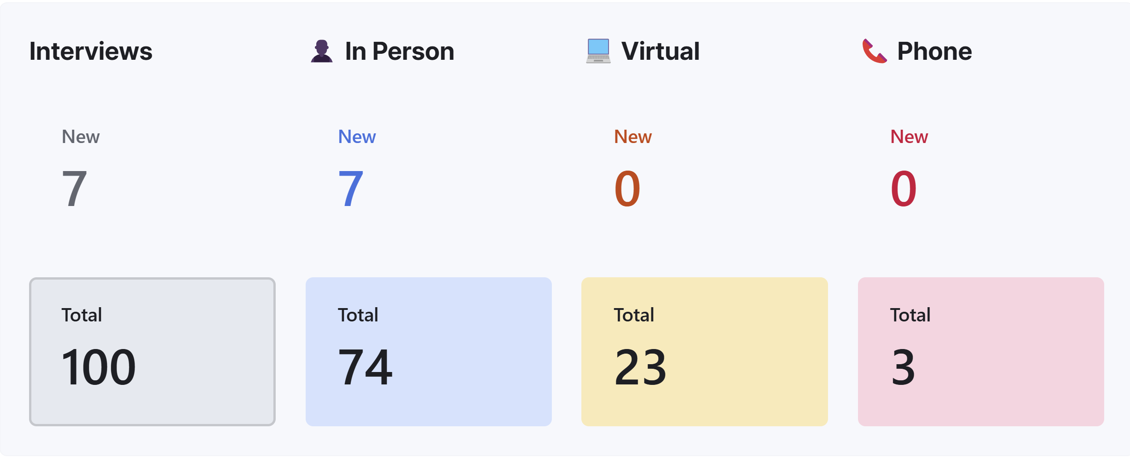


#3605 SemiCon Power Innovators
Initial Motive : Build High Power Devices (>6.6kV)
Initial Customer Segment : DoD, EV, and Aerospace
Initial Why Us Moment : High Voltage Tolerance & Higher Efficiency
Initial Business Thesis : Semicon Power Innovators will serves defense, EV manufacturers, and aerospace industries by offering high-power devices with voltage tolerances over 6.6kV. Our products will be a good choice for businesses looking for greater voltage tolerance and higher efficiency in their devices.

Slide 2



#3605 SemiCon Power Innovators
Dr. Iftikhar Ahmad is an Assistant Professor in Electrical Engineering at USC. His expertise include ultrawide bandgap materials and their applications. He served as a technical lead in Semicon Power Innovators
M Hassan Tahir is a graduate student in Electrical engineering at USC. He served as an entrepreneurial lead in team Semicon Power Innovators
Dr. Necmi Altin is a research fellow in Electrical Engineering. He has more than 10+ years of industrial experience and he’s serving as the Industrial mentor in team Semicon Power Innovators.

Slide 3
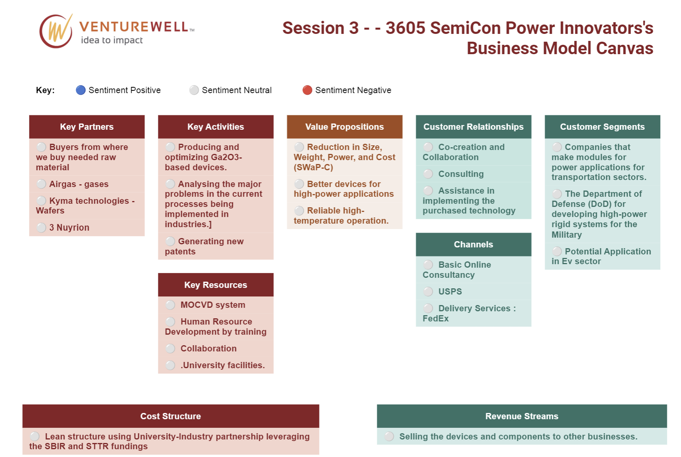
What we thought in the Beginning

Slide 4
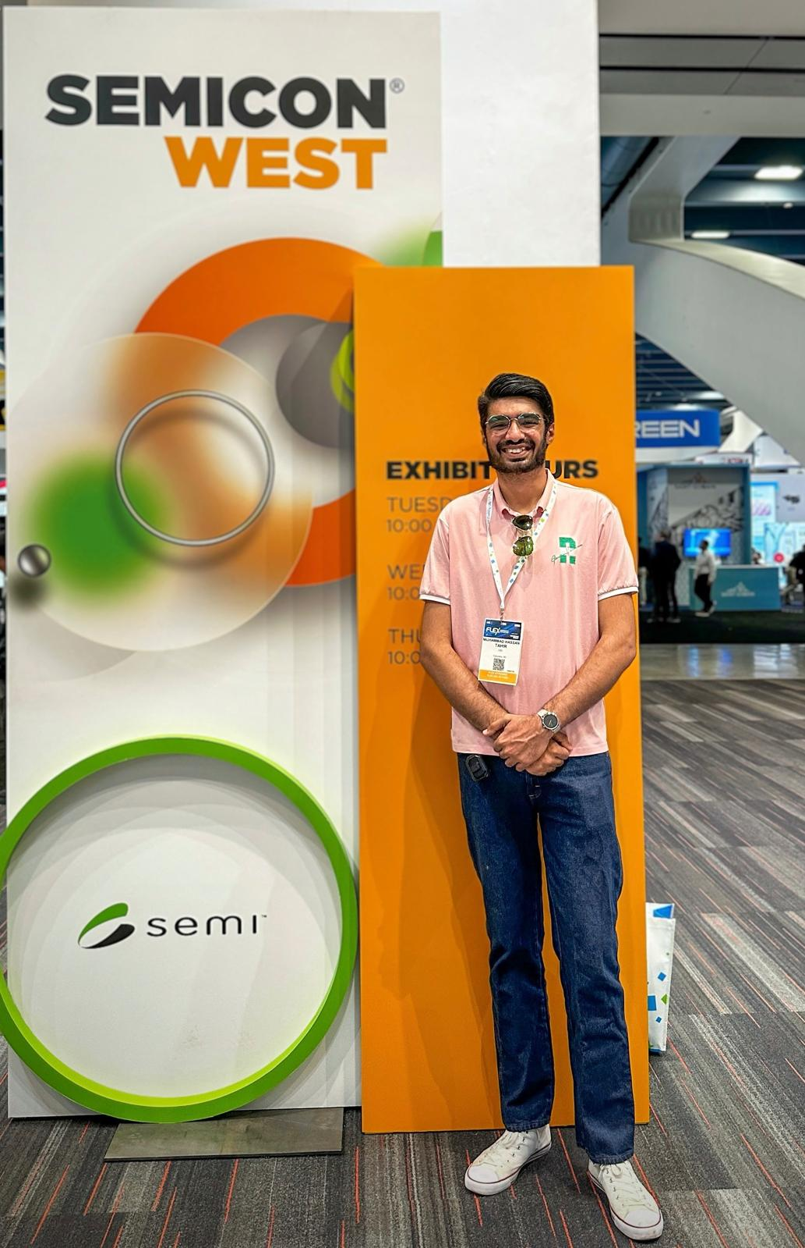
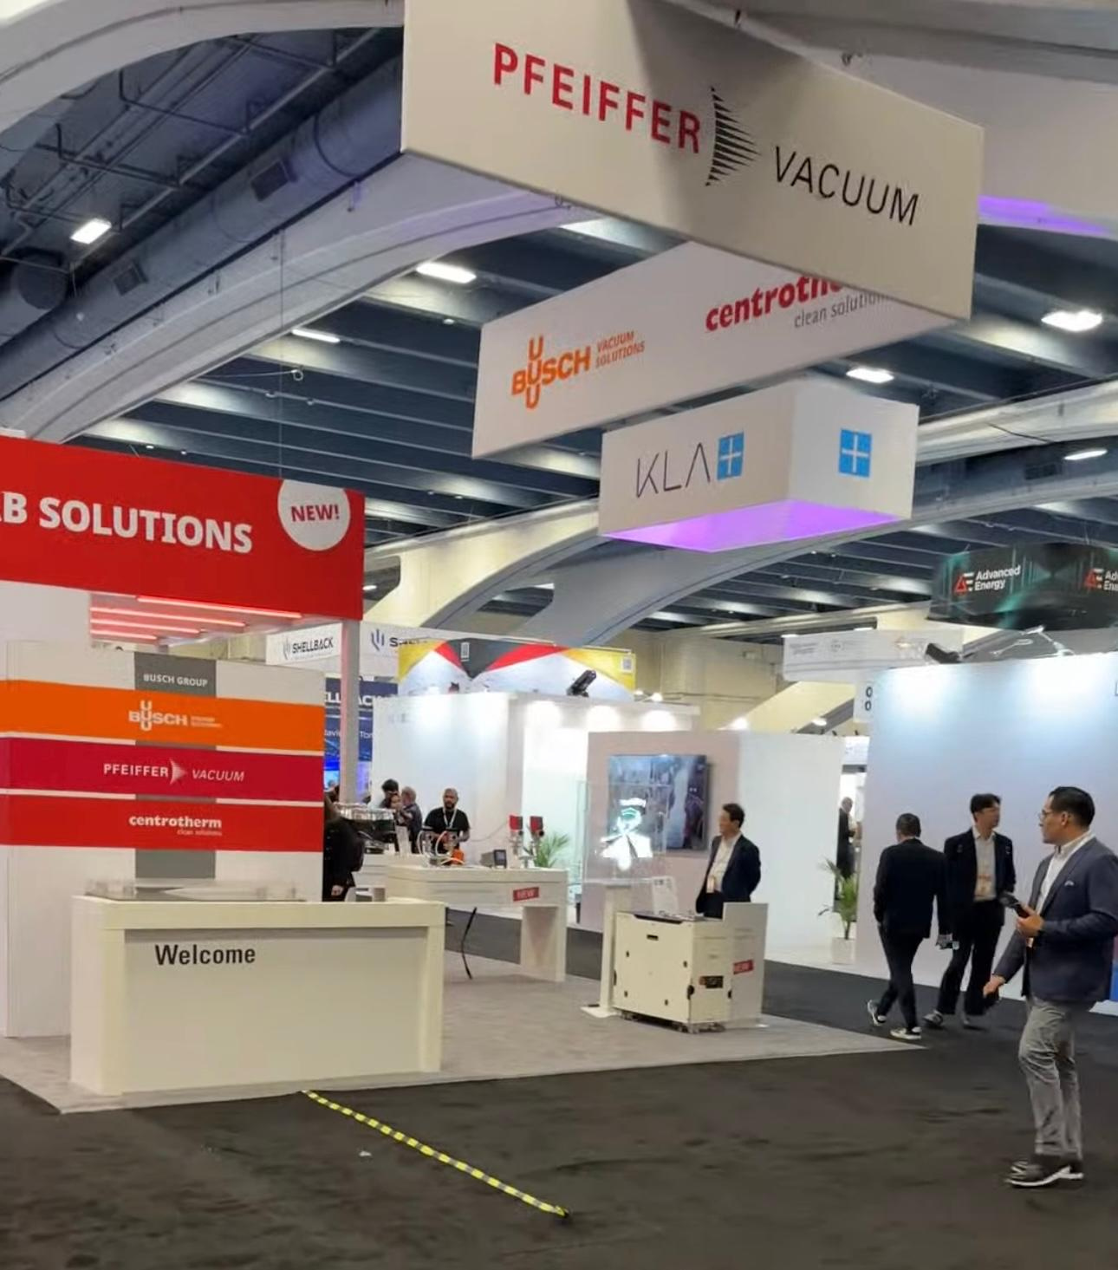
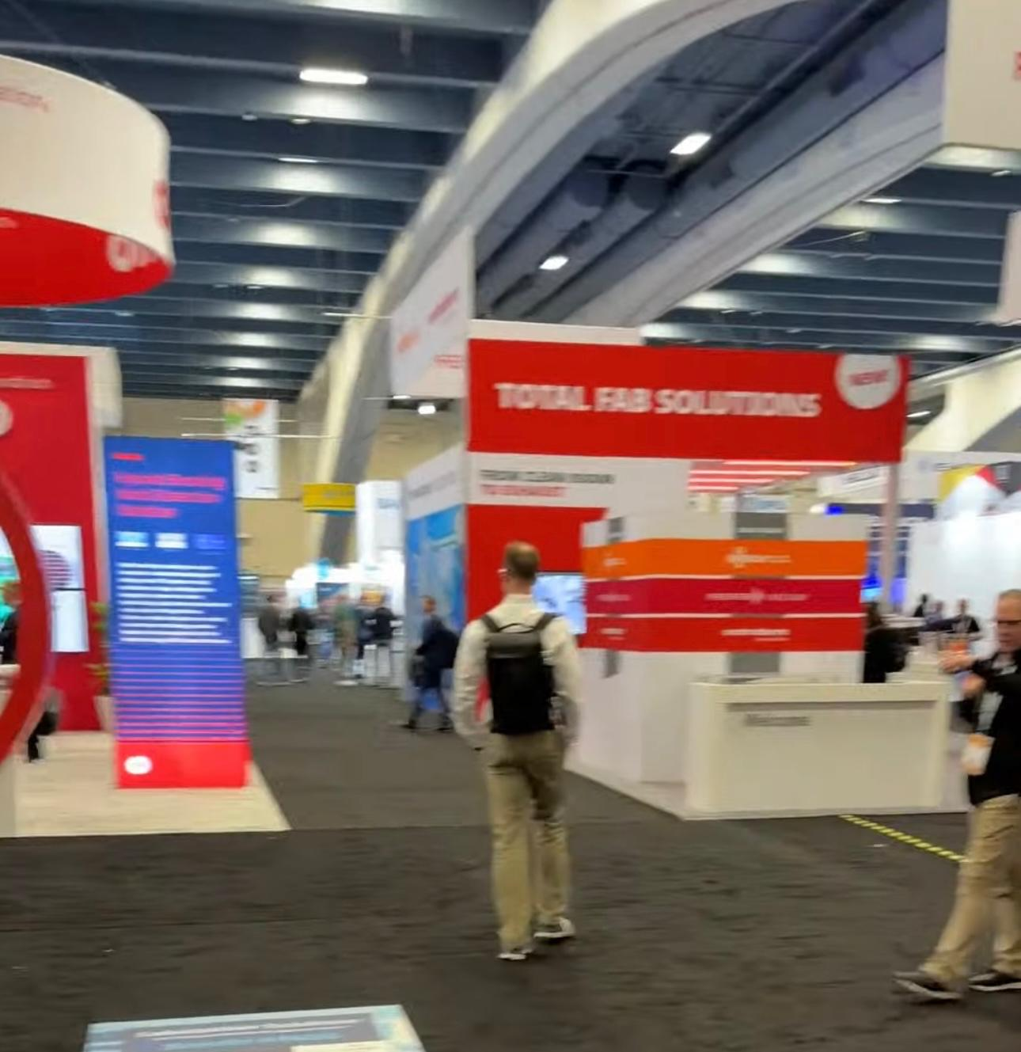
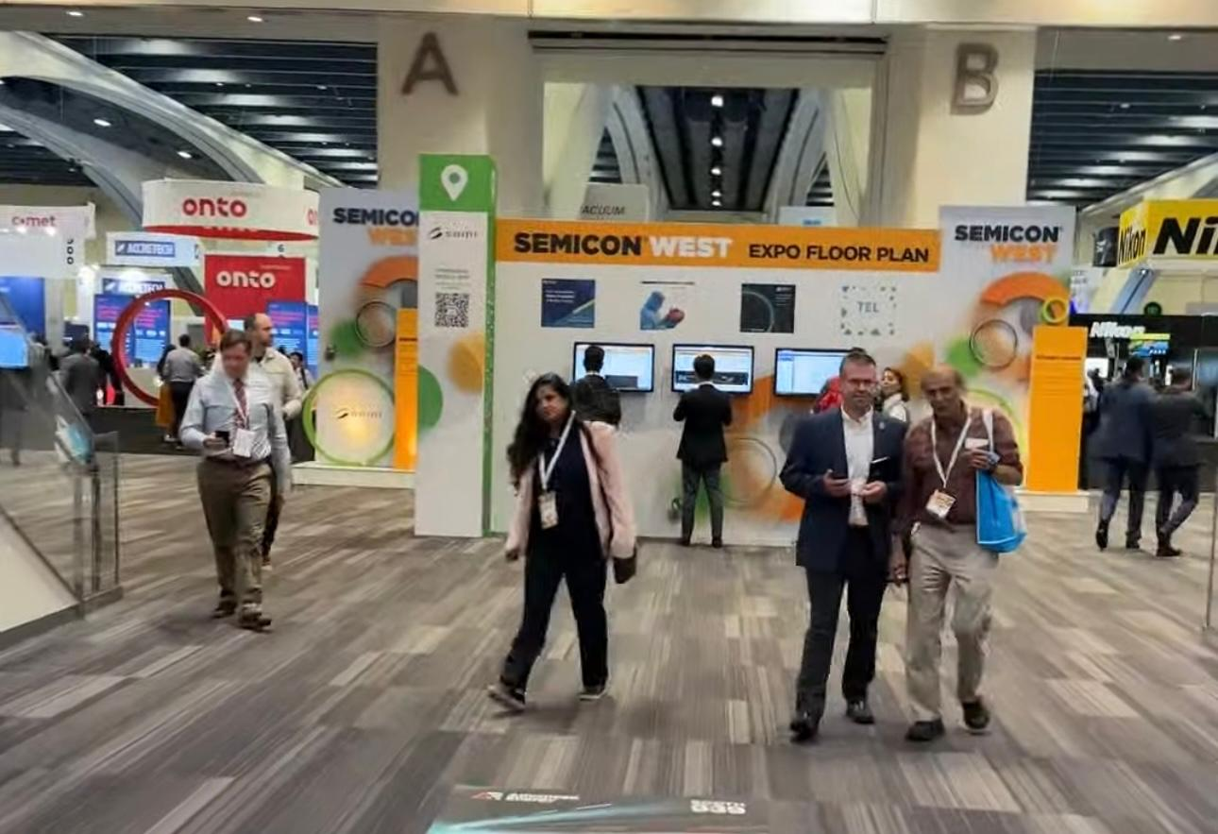
Initial Customer Discovery
Conference #1 : Semi-Con West 2024
Target Audience
1.High power Electronics device manufacturers.
2. EV manufacturers
3. Raw Material Suppliers
4. Research Engineers

Slide 5










What we learned ??
Companies Interviewed (35+)
Lessons Learned
Major Issue in Scalability
Problem in Reliability
Not Profitable for Industry
Major Break through needed
Industry Shit needed
Very Niche Target market

Slide 6
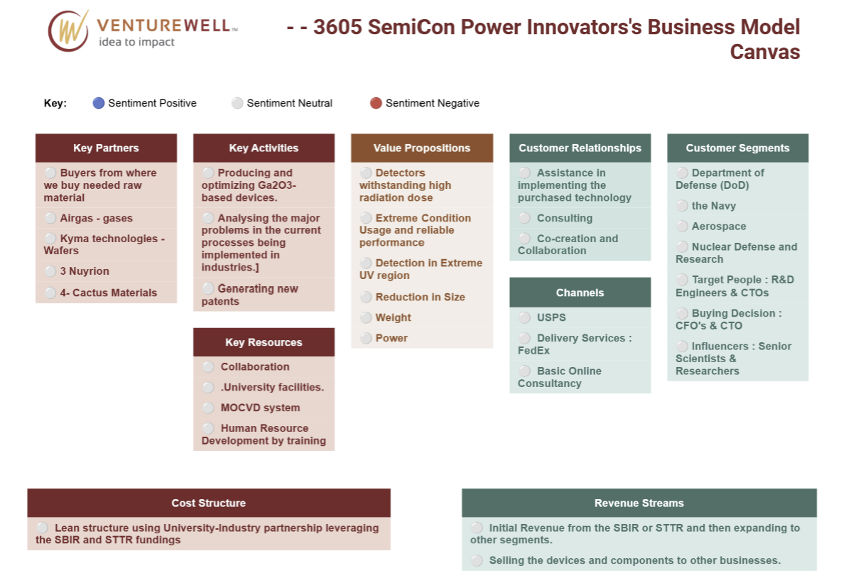
Pivot Needed
Updated Business Thesis : High-precision industries, such as aerospace and nuclear, will adopt our gallium oxide-based detectors for their superior sensitivity, thermal stability, enhanced signal to noise ratio and radiation resistance in extreme environments.

Slide 7
Plan Moving Forward
New Hypothesis:
Traditional materials in detectors do not meet the performance requirements for extreme conditions.
High sensitivity and accuracy is important in low signal or high noise environments.
Maintenance costs of detectors is high cause of smaller operational lifetimes in harsh environments.
Ga₂O₃ wide bandgap enables high-temperature operation, reducing the need for expensive cooling systems.
Ga₂O₃ detectors will demonstrate comparable or superior gamma-ray detection capabilities compared to conventional materials like CZT or HPGe.
Updated Interview Question?
What material-based detectors would you prefer if you are planning to do detection in high temperature or extreme radiation environment?
What your go to technique to improve the sensitivity and accuracy of your detectors?
How do you think the current detectors CZTs, HPGEs can be improved ?
What are your thoughts on the potential of wide-bandgap materials like Ga₂O₃ for high-radiation environments?
What key features would a next-generation detector need to have for your company to consider adopting it?
Do you typically engage with startups?? If so and what are your key expectations in a collaboration?
Do you Co-develop new solution, or you prefer licensing ?
Do you allow customization of components?
Have your materials being used in holistic environments if so, what's the performance looks like ?
Pricing and discounts on bulk orders?
Virtual / In-person Consultations?? Trial versions?
Global shipping? Time and logistics ?
Doing Customer Discovery Focused on detectors

Slide 8
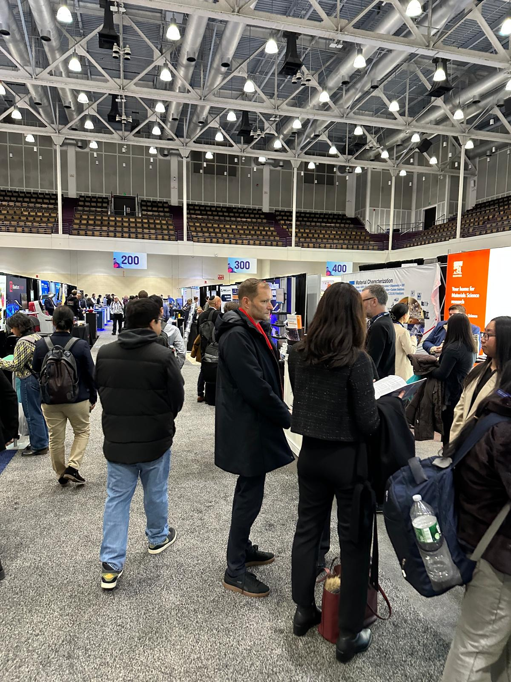
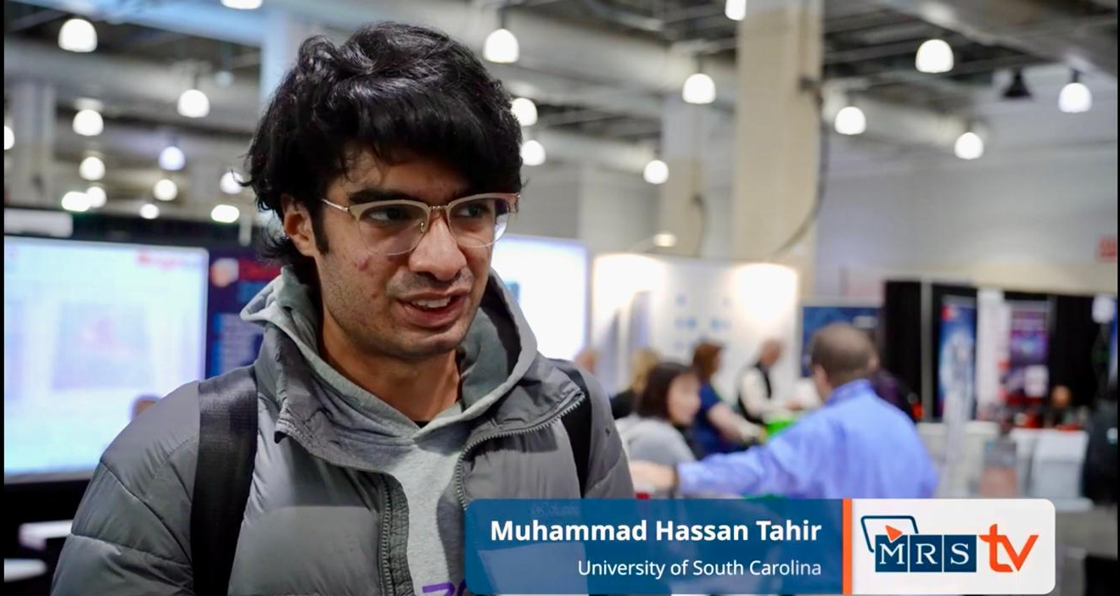
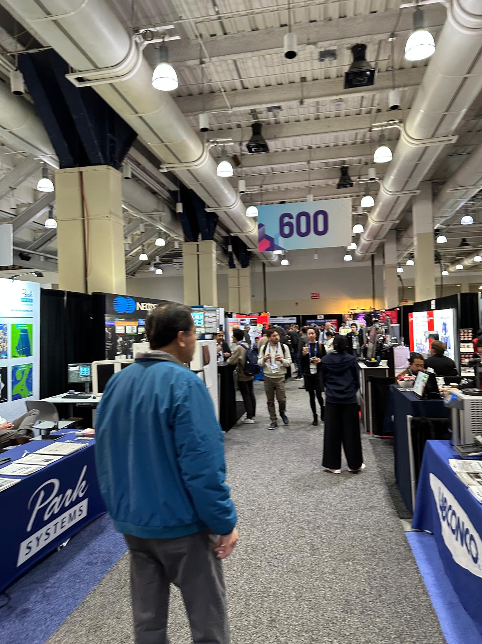
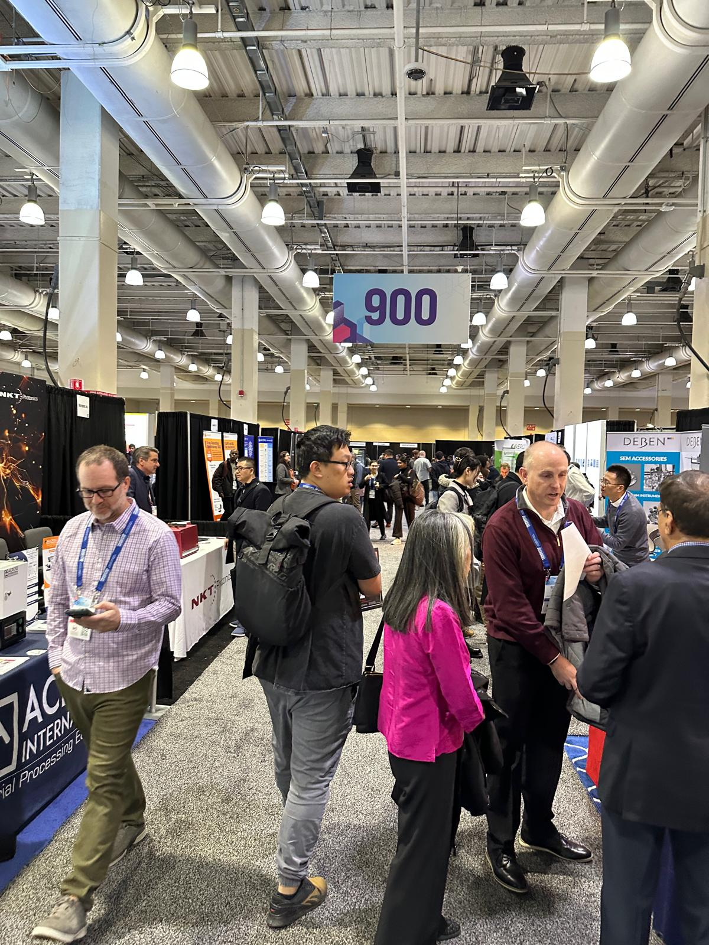
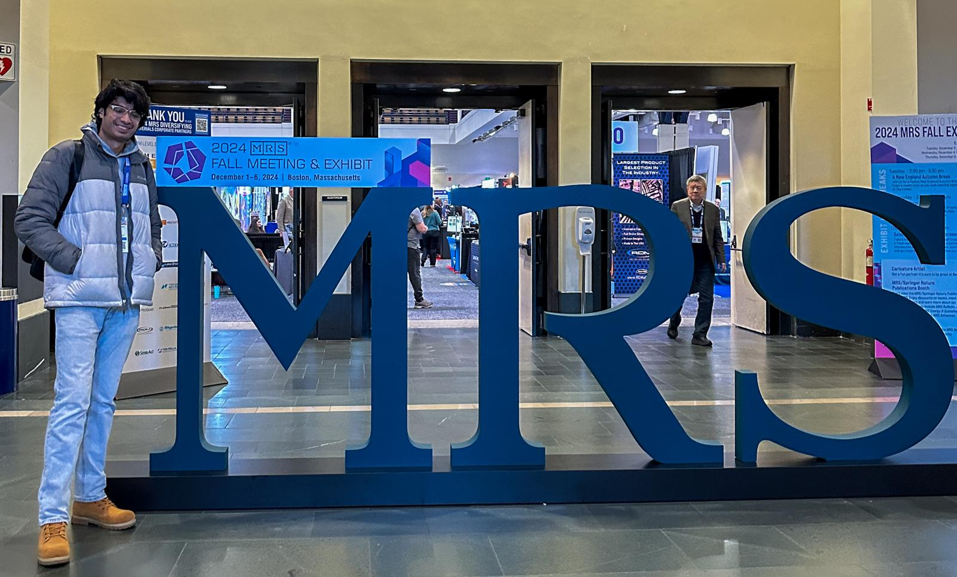
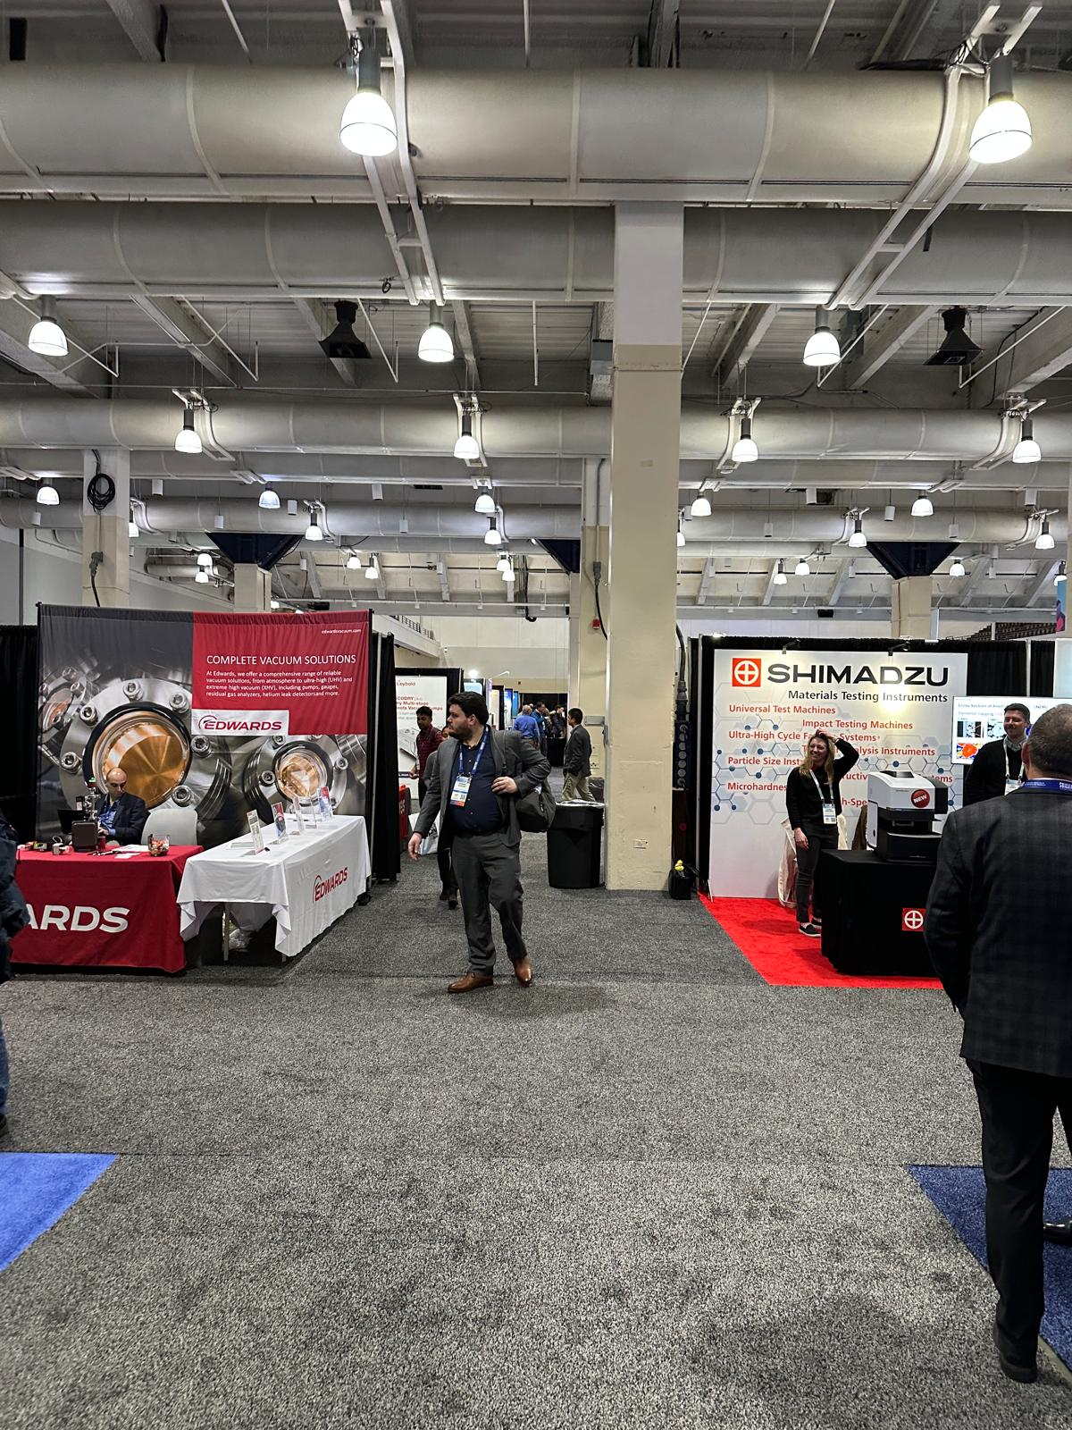
2nd Customer Discovery
Conference #2&3 : IEEE NPSS and MRS 2024
Target Audience
Nuclear Equipment Manufacturers
Detectors Manufacturers
Research Engineers
Technical Officers

Slide 9








What we learned ??
Companies Interviewed (60+)
Lessons Learned
Scalability issues
Reliability main concern
Less Mature Fabrication
Similar Research in various R&D of industries
If the Ga₂O₃ production scales up, economies of scale could significantly lower costs.

Slide 10
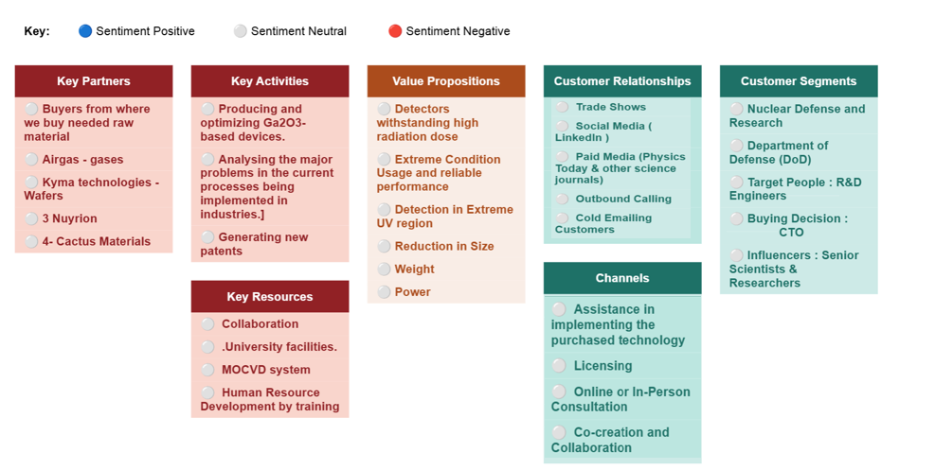
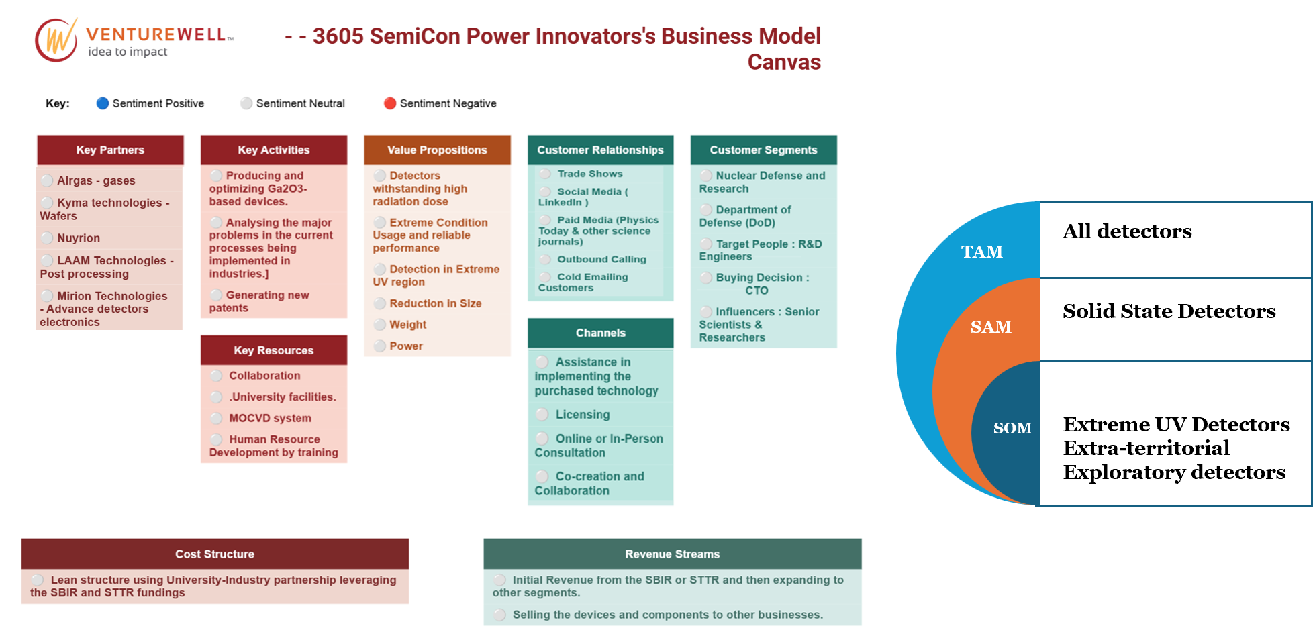
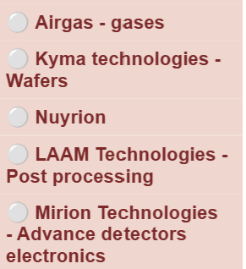
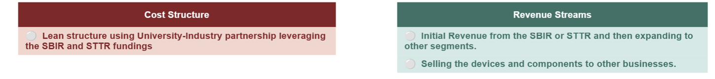
Final BMC
Latest Business Thesis : Research engineers & Safety Technicians in nuclear industries will adopt our gallium oxide-based detectors for their improved signal-to-noise ratio, and radiation resistance in extreme environments.
All detectors
TAM
Solid State Detectors
SAM
SOM
Extreme UV Detectors Extra-territorial Exploratory detectors

Slide 11
Path Forward

